Slide 1
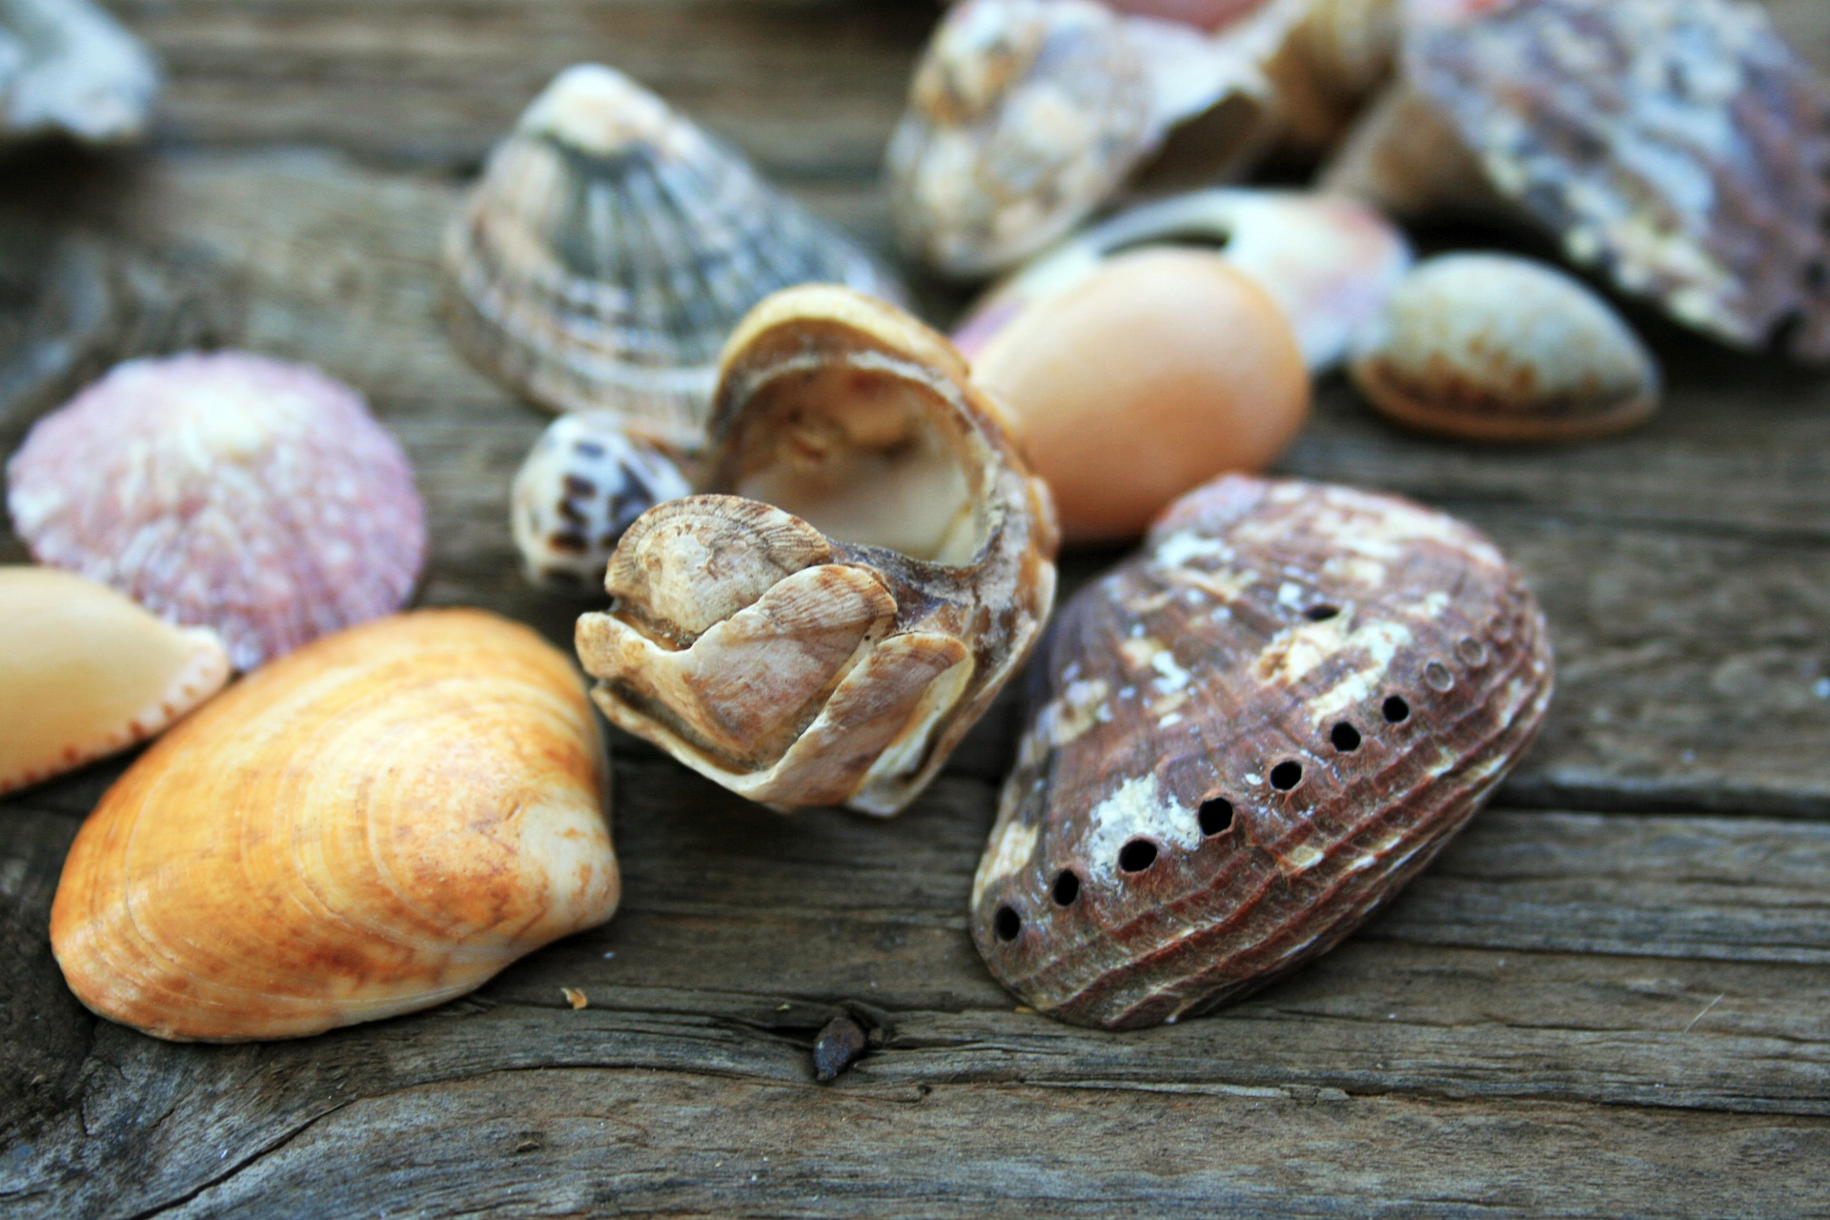
“Predicting the age of Abalone”
First stage of Project
Danil Kirilenko
Ilda Alushaj

Slide 2
Датасет (https://archive.ics.uci.edu/ml/datasets/Abalone) :
Cостоит из описания физических характеристик 4177 морских ушек (8 описательных признаков и 1 целевой – количество колец/возраст).
Есть как категориальные, так и числовые признаки.
Мы занимались решением двух задач:
1- предсказание самых часто встречающихся классов (7, 8, 9)
2- сравнение классификаторов и регрессоров для большего числа классов (19).

Slide 3
Первая часть Pешение задачи мультиклассовой (3) классификации
Normalization of data 1. Convert categorical feature into numerical one 2. Garbage in/ Garbage out ( Check if we have any missing values ) 3.Check if all values are int/float
Selecting the target feature (number of rings) and classes for prediction (7, 8 and 9).
Visualizing the dependence of specific features on the target feature using graphics
Removing outliers that have no useful information for our data prediction
Splitting our data into Train and Test data
Creating classification models : 1. Support Vector Machine (SVM) 2. Random Forest Classifier 3. Gradient Boosting 4. KNN

Slide 4
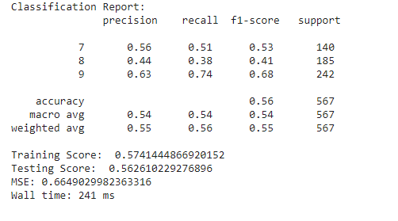
“ Support Vector Machine - SVM “
Using Grid Search Algorithm (Hyperparameter tuning ) to get the best parameters for our model
In SVM - Grid Search gave us this best parameters : ({'C': 1.0, 'gamma': 10}, 0.5337704836165706)

Slide 5
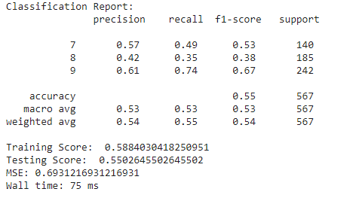
“Random Forest Classifier”
Grid search parameters : ({'max_depth': 3, 'n_estimators': 10}, 0.5386909059783622)

Slide 6
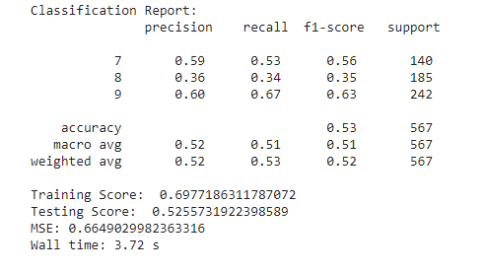
Gradient Boosting
Grid search hyperparameter tunning :
({'learning_rate': 0.01, 'max_depth': 3, 'n_estimators': 400}, 0.5320544160621445)

Slide 7
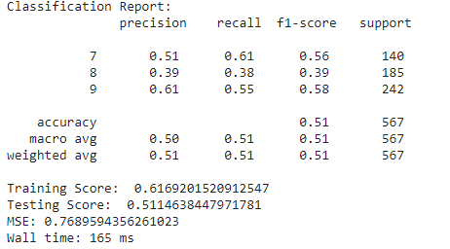
Knearest Neighbours -KNN
Grid search best parameters :
({'metric': 'minkowski', 'n_neighbors': 8, 'weights': 'uniform'}, 0.5145910538232238)

Slide 8
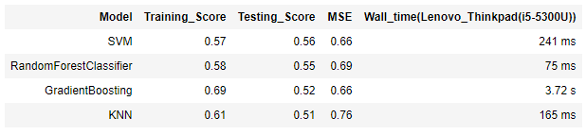
Results :
From the table, we can see that the best result was in SVM model with an accuracy 0.56 and a MSE(mean square error) 0.66. Wall time is 241 ms.

Slide 9
Вторая часть: сравнение классификационного и регрессионного подходов для предсказания возраста морских ушек от 3 лет до 21 года (19 классов)
Data preprocessing is done in the same way as in the first part.
We build classification and regression models: LogReg, LinReg, RandomForest, GradientBoosting.
To calculate the percentage of correct responses in regression models and then compare them with their classification counterparts, the regressor predictions are rounded to the nearest integer.

Slide 10


Random Forest Classifier
Random Forest Regressor

Slide 11


Gradient Boosting Classifier
Gradient Boosting Regressor

Slide 12
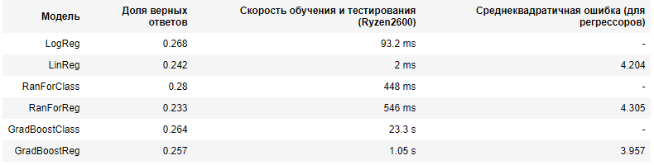
Results :
All pairs of classifiers coped with the task better than the regressors.However, the best classifier was Random Forest, when Gradient Bossting was the best among regressors

